Slide 1
Recap – Global E-business and Collaboration
Business Processes and Information Systems
Types of Information Systems – TPS, BIS, MIS, DSS, ESS, Enterprise Apps.
Types of Enterprise Applications
    Enterprise systems
    Supply chain management systems
    Customer relationship management systems
    Knowledge management systems
Systems for Collaboration and Teamwork
Notes:
Students may not know exactly what is meant by globalization or may have an incomplete understanding of the term. You might ask students what they think it means. Potential answers could include: reduction of economic and cultural advantages of developed countries, increased number of companies with operations in multiple countries worldwide, and increased reliance on imports and exports of goods (and jobs). Globalization will be discussed in later slides as well.

Slide 2
Recap – Information Systems, Organizations and Strategy
Organizations and Information Systems
How Information Systems impact Organizations & Business Firms.
Using Information Systems to achieve competitive advantage
Michael Porter’s competitive model. Five competitive forces that shape the fate of a firm:
Notes:
Students may not know exactly what is meant by globalization or may have an incomplete understanding of the term. You might ask students what they think it means. Potential answers could include: reduction of economic and cultural advantages of developed countries, increased number of companies with operations in multiple countries worldwide, and increased reliance on imports and exports of goods (and jobs). Globalization will be discussed in later slides as well.

Slide 3
Recap – Information Systems, Organizations and Strategy
    Traditional Competitors
    New Market Entrants
    Substitute products and services
    Suppliers
    Customers
The Value Chain Model
Notes:
Students may not know exactly what is meant by globalization or may have an incomplete understanding of the term. You might ask students what they think it means. Potential answers could include: reduction of economic and cultural advantages of developed countries, increased number of companies with operations in multiple countries worldwide, and increased reliance on imports and exports of goods (and jobs). Globalization will be discussed in later slides as well.

Slide 4
Ethical and Social Issues in Information Systems
VIDEO CASES:
  Case 1: Data Mining for Terrorists and Innocents

Slide 5
Learning Objectives
What ethical, social, and political issues are raised by information systems?
What specific principles for conduct can be used to guide ethical decisions?
Why do contemporary information systems technology and the Internet pose challenges to the protection of individual privacy and intellectual property?
How have information systems affected everyday life?
Notes:
This chapter examines the ethical, social, and political issues raised by information systems. It can be useful to ask students to help you put together a list of these issues categorized into ethical, social, and political columns.

Slide 6
Understanding Ethical and Social Issues Related to Systems
Recent cases of failed ethical judgment in business:
  Barclay’s Bank, GlaxoSmithKline, Walmart
  In many, information systems used to bury decisions from public scrutiny
  Kenyan Banks – 1 billion losses in 2013 tripled!
Ethics
  Principles of right and wrong that individuals, acting as free moral agents, use to make choices to guide their behaviors
Notes:
There are numerous examples of business ethical failures to ask students about. You could ask how information systems or their absence might have been related to the current financial crisis in the United States, the investment banks that have suffered heavy losses, and individuals who were able to defraud investors of millions. What role did IS have in this crisis? The Madoff Ponzi scheme is instructive: systems were used for more than twenty years to fool investors, regulators, and investigators about the true nature of Madoff’s business.

Slide 7
Understanding Ethical and Social Issues Related to Systems
Barclays:
  Fined £290M by UK & US regulators for rigging inter-bank lending rate - Libor in ’13.
  Resignation of CEO – Bod Diamond in August
  New CEO Antony Jenkins – memo to 140K staff worldwide on 5 core ethical values: respect, integrity, service, excellence and stewardship – the ‘go to’ bank.
  “Performance assessment will be based not just on what we deliver, but on how we deliver it.”
  Challenge: Linking performance with values!
Notes:
There are numerous examples of business ethical failures to ask students about. You could ask how information systems or their absence might have been related to the current financial crisis in the United States, the investment banks that have suffered heavy losses, and individuals who were able to defraud investors of millions. What role did IS have in this crisis? The Madoff Ponzi scheme is instructive: systems were used for more than twenty years to fool investors, regulators, and investigators about the true nature of Madoff’s business.

Slide 8
Understanding Ethical and Social Issues Related to Systems
GlaxoSmithKline:
  Fined $3B to resolve criminal & civil liability for unlawful promotion of some prescription drugs, failure to report safety data, false price reporting practices - ’13.
  Largest payment ever by a drug company
  GSK guilty to a three-count criminal info. charge:
    introducing misbranded drugs, Paxil (‘98-’03: anti-depressant sold without FDA approval) and Wellbutrin (‘99-’03: approved for depression sold as treatment for weight loss, ADHD etc) into interstate commerce.
    failing to report safety data about the drug Avandia (‘01-’07: diabetes drug) to the FDA.
  Challenge: Linking performance with values!
Notes:
There are numerous examples of business ethical failures to ask students about. You could ask how information systems or their absence might have been related to the current financial crisis in the United States, the investment banks that have suffered heavy losses, and individuals who were able to defraud investors of millions. What role did IS have in this crisis? The Madoff Ponzi scheme is instructive: systems were used for more than twenty years to fool investors, regulators, and investigators about the true nature of Madoff’s business.

Slide 9
Understanding Ethical and Social Issues Related to Systems
Walmart:
  The New York Times exposed the international retail giant’s history of bribing Mexican govt. officials to dominate that market - ’12.
  Top executives:
    ignored stern advice from its general counsel and internal investigator.
    lobbied to dilute the U.S. Foreign Corrupt Practices Act (FCPA), which prohibits payment of anything of value to foreign officials to obtain or retain business.
    violated Mexican anti-bribery laws, the FCPA, and the U.K. Bribery Act (by virtue of certain corporate holdings).
  Challenge: Linking performance with values!
Notes:
There are numerous examples of business ethical failures to ask students about. You could ask how information systems or their absence might have been related to the current financial crisis in the United States, the investment banks that have suffered heavy losses, and individuals who were able to defraud investors of millions. What role did IS have in this crisis? The Madoff Ponzi scheme is instructive: systems were used for more than twenty years to fool investors, regulators, and investigators about the true nature of Madoff’s business.

Slide 10
Understanding Ethical and Social Issues Related to Systems
Information systems and ethics
  Information systems raise new ethical questions because they create opportunities for:
    Intense social change, threatening existing distributions of power, money, rights, and obligations
    New kinds of crime e.g. Kenya’s BFID: identity theft, electronic funds transfer, bad cheques, credit card fraud, loan fraud, forgery of documents and online fraud.
Notes:
Ask students to describe some of the ethical dilemmas that are presented by information systems and new developments in technology. Privacy is an important issue—mention the opening case again and explain that the business models of Google, Facebook, and many other sites depend on getting users to give up their personal information so it can be used to market and sell them products.

Slide 11
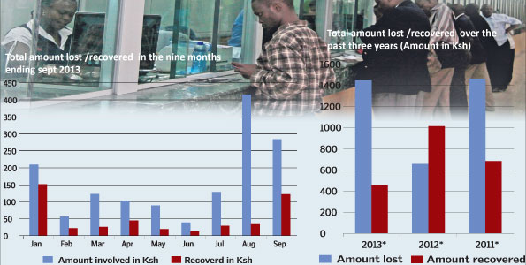
Understanding Ethical and Social Issues Related to Systems
Kenya’s Banks:
  “Shock as Kenyan bank losses to fraud triple to Sh1.6bn” – Sept ‘13.
  http://www.theeastafrican.co.ke/news/Kenyan-banks-lose--18-8m-to-savvy-fraudsters/-/2558/2057524/-/gfy7g3z/-/index.html
Notes:
There are numerous examples of business ethical failures to ask students about. You could ask how information systems or their absence might have been related to the current financial crisis in the United States, the investment banks that have suffered heavy losses, and individuals who were able to defraud investors of millions. What role did IS have in this crisis? The Madoff Ponzi scheme is instructive: systems were used for more than twenty years to fool investors, regulators, and investigators about the true nature of Madoff’s business.

Slide 12
Understanding Ethical and Social Issues Related to Systems
A model for thinking about ethical, social, and political Issues
  Society as a calm pond
  IT as rock dropped in pond, creating ripples of new situations not covered by old rules.
  Social and political institutions cannot respond overnight to these ripples - it may take years to develop etiquette, expectations, laws.
    Requires understanding of ethics to make choices in legally gray areas.
Notes:
Can students provide any examples of how IT has challenged some area of ethics, social life, or legal arrangements?

Slide 13
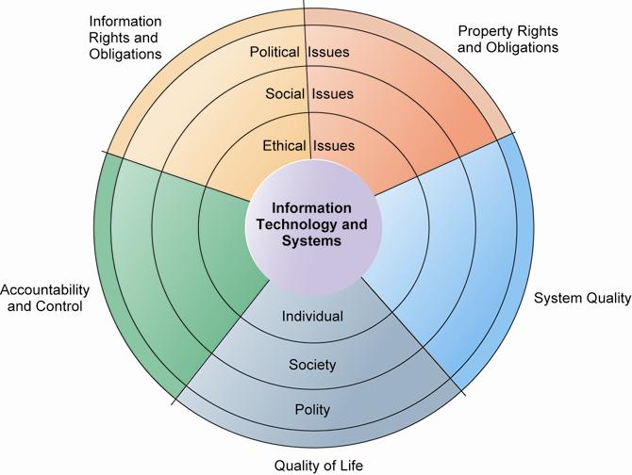
THE RELATIONSHIP AMONG ETHICAL, SOCIAL, POLITICAL ISSUES IN AN INFORMATION SOCIETY
The introduction of new information technology has a ripple effect, raising new ethical, social, and political issues that must be dealt with on the individual, social, and political levels. These issues have five moral dimensions: information rights and obligations, property rights and obligations, system quality, quality of life, and accountability and control.
FIGURE 1
Notes:
Explain to students that the graphic displays the five moral dimensions listed in the caption. Consider online P2P bit torrent shared music as an example of how a new technology has ethical, social, and eventually political (legal) ramifications. If music can be ripped off, why pay any money for it? Why should anyone care about record labels or artist’s income?

Slide 14
Understanding Ethical and Social Issues Related to Systems
Five moral dimensions of the info. age:
  Information rights and obligations:
    What information rights do individuals and organizations possess with respect to information about themselves? What can they protect? What obligations do individuals and organizations have concerning this information?
  Property rights and obligations:
    How will traditional intellectual property (IP) rights be protected in a digital society in which tracing and accounting for ownership is difficult, and ignoring such property rights is so easy?
Notes:
Give examples of each of the five major issues. For example, an issue dealing with information rights might be, what rights do individuals possess with respect to themselves? What do they have a right to protect? An issue dealing with quality of life might be: what values should be preserved in an information- and knowledge-based society? An issue dealing with system quality might be: what standards of data and system quality should we demand to protect individual rights and the safety of society?

Slide 15
Understanding Ethical and Social Issues Related to Systems
Five moral dimensions of the info. age:
  Accountability and control:
    Who can and will be held accountable and liable for the harm done to individual and collective information and property rights?
  System quality:
    What standards of data and system quality should we demand to protect individual rights and the safety of society?
  Quality of life:
    What values should be preserved in an info. & knowledge-based society? What institutions should we protect from violation? What cultural values and practices are supported by the new information technology?

Slide 16
Understanding Ethical and Social Issues Related to Systems
Key technology trends that raise ethical issues:
  Doubling of computer power
    More organizations depend on computer systems for critical operations.
  Rapidly declining data storage costs
    Organizations can easily maintain detailed databases on individuals.
  Networking advances and the Internet
    Copying data from one location to another and accessing personal data from remote locations are much easier.
Notes:
Which of these trends do students believe might have the most adverse consequences? Why do they feel this way? Do the positives outweigh the negatives for all four issues? Why or why not?

Slide 17
Understanding Ethical and Social Issues Related to Systems
  Advances in data analysis techniques
    Profiling
      Combining data from multiple sources to create dossiers of detailed information on individuals.
    Nonobvious relationship awareness (NORA)
      Combining data from multiple sources to find obscure hidden connections that might help identify criminals or terrorists.
  Mobile device growth
    Tracking of individual cell phones.
Notes:
Online profiling is one of the most controversial computer-related ethical, social, and political issues today. Although it is used fairly extensively on the Internet, it is also used by insurance firms, health insurance firms, casinos, and of course national authorities around the globe for finding potential terrorists.

Slide 18
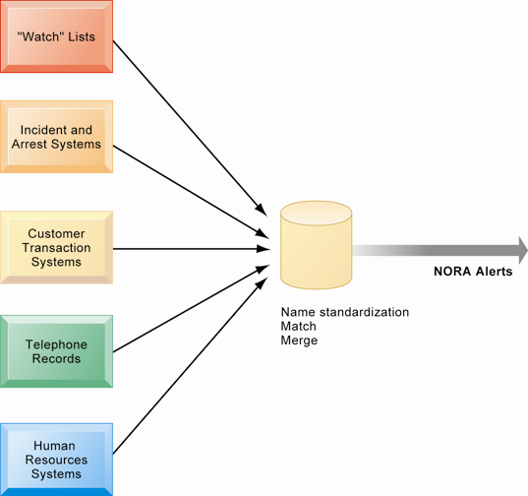
NONOBVIOUS RELATIONSHIP AWARENESS (NORA)
NORA technology can take information about people from disparate sources and find obscure, nonobvious relationships. It might discover, for example, that an applicant for a job at a casino shares a telephone number with a known criminal and issue an alert to the hiring manager.
FIGURE 2
Notes:
Explain that NORA is used by both the government and the private sector for its profiling capabilities. Ask students to provide potential examples of NORA (other than the one mentioned in the caption) for both governmental and business purposes. One such example might be an airline identifying potential terrorists attempting to board a plane. Another might be government identifying potential terrorists by monitoring phone calls.

Slide 19
Ethics in an Information Society
Basic concepts for ethical analysis
  Responsibility:
    Accepting the potential costs, duties, and obligations for decisions
  Accountability:
    Mechanisms for identifying responsible parties
  Liability:
    Permits individuals (and firms) to recover damages done to them
  Due process:
    Laws are well-known and understood, with an ability to appeal to higher authorities
Notes:
Explain that information systems do not exist in a vacuum and that these concepts are instrumental in understanding the impact of systems and measuring their success. Ask students why liability and due process are such important ethical concepts? (A rough answer would be that they provide recourse to individuals negatively effected by mismanagement of information systems, providing incentive to “play by the rules”.)

Slide 20
Ethics in an Information Society
Five-step ethical analysis
  Identify and clearly describe the facts.
  Define the conflict or dilemma and identify the higher-order values involved.
  Identify the stakeholders.
  Identify the options that you can reasonably take.
  Identify the potential consequences of your options.
Notes:
Do students believe that any aspect of ethical analysis is lacking from this process? If so, what? Can students offer a brief example of an ethical dilemma and how they would resolve it using this process? One class exercise is to work with students to identify an ethical situation they are aware of, or that may have been in the news. Then, go through the ethical analysis described in the slide to illustrate the process of analyzing an ethical situation.

Slide 21
Ethics in an Information Society
Candidate ethical principles
  Golden Rule
    Do unto others as you would have them do unto you.
  Immanuel Kant’s Categorical Imperative
    If an action is not right for everyone to take, it is not right for anyone.
  Descartes’ Rule of Change
    If an action cannot be taken repeatedly, it is not right to take at all.
Notes:
Ensure students understand the difference between the categorical imperative and the rule of change. Briefly, the difference is that the categorical imperative spans the entirety of the populace, whereas the rule of change applies to the decisions of one person over time. For example, the categorical imperative applies to an employee who tries to steal money from his employer. He shouldn’t do this, because if all employees attempted to do so, the company would fail. The rule of change applied to the same situation might run as follows: although the employee’s stealing one dollar from the company would not lead to any true problem, repeatedly stealing one dollar, or stealing a lot of dollars, would be unacceptable and ultimately lead to the destruction of the company.

Slide 22
Ethics in an Information Society
Candidate ethical principles (cont’d)
  Utilitarian Principle
    Take the action that achieves the higher or greater value.
  Risk Aversion Principle
    Take the action that produces the least harm or potential cost.
  Ethical “No Free Lunch” Rule
    Assume that virtually all tangible and intangible objects are owned by someone unless there is a specific declaration otherwise.
Notes:
How does the “no free lunch” rule relate to copyrights, patents, and trademarks? (These concepts are discussed in later slides.)
Explain that the appearance of unethical behavior is as harmful as actual unethical behavior at times, so adherence to these principles are critical. In an age of “open source software” how does the principle of “no free lunch” work out? Open source software is an example of an economic good which is licensed by the creator for distribution often without charge, or even attribution. In this case, there is a “free lunch.” But it occurs because the creators of the software consent to this arrangement.

Slide 23
Ethics in an Information Society
Professional codes of conduct
  Promulgated by associations of professionals
    Examples: American Medical Assoc. (AMA), American Bar Assoc. (ABA), Assoc. of IT Professionals (AITP), Assoc. for Computing Machinery (ACM), Computer Soc. of Kenya (CSK).
  Promises by professions to regulate themselves in the general interest of society.
Real-world ethical dilemmas
  One set of interests pitted against another
    Example: right of company to maximize productivity of workers versus workers’ right to use Internet for short personal tasks.
Notes:
Other ethical dilemmas include companies trying to use new systems to reduce the size of their workforce, such as telephone companies using automated systems to reduce the need for human operators. Emphasize that in cases like these, right and wrong are not clearly defined, but instead, contrasting values are at odds with one another (companies value productivity, employees value their work).

Slide 24
The Moral Dimensions of Information Systems
Information rights: privacy and freedom in the Internet age
  Privacy:
    Claim of individuals to be left alone, free from surveillance or interference from other individuals, organizations, or state; claim to be able to control information about yourself
  In the United States, privacy protected by:
    First Amendment (freedom of speech)
    Fourth Amendment (unreasonable search and seizure)
    Additional federal statues (e.g. Privacy Act of 1974)
Notes:
Do students believe that there are sufficient protections for privacy in law? If not, what are possible methods of developing appropriate privacy protections? Table 4-3 in the text lists a variety of other laws affecting both the government and private institutions, but few areas of the private sector are as well regulated with respect to privacy. Do an in-class poll and ask students who among them feel they can control the use of their personal information on the Internet. You should get no one raising their hand.

Slide 25
The Moral Dimensions of Information Systems
Fair information practices:
  Set of principles governing the collection and use of information
    Basis of most U.S. and European privacy laws
    Based on mutuality of interest between record holder and individual
    Restated and extended by Federal Trade Commission (FTC) in 1998 to provide guidelines for protecting online privacy
  Used to drive changes in privacy legislation
    Children's Online Privacy Protection Act (COPPA) of 1998 - to protect children
    Gramm-Leach-Bliley Act 1999 - on how financial institutions handle client data.
    Health Insurance Portability & Accountability Act (HIPAA) of 1996 - for Health Insurance protection
    Do-Not-Track Online Act of 2011 - protects users’ right to choose whether or not to be tracked by third-party websites
Notes:
Explain what is meant by a “mutuality of interest between record holder and individual.” (Briefly, the individual wants to engage in a transaction, and the record holder needs information about the individual to support the transaction—both are interested parties in the transaction.)

Slide 26
The Moral Dimensions of Information Systems
FTC Fair Info Practice (FIP) principles:
  Notice/awareness (core principle)
    Web sites must disclose practices before collecting data.
  Choice/consent (core principle)
    Consumers must be able to choose how information is used for secondary purposes.
  Access/participation
    Consumers must be able to review and contest accuracy of personal data.
Notes:
Do students believe that the Web sites they visit actually disclose their data collection and utilization practices? Is it difficult to find where?

Slide 27
The Moral Dimensions of Information Systems
FTC FIP principles (cont’d)
  Security
    Data collectors must take steps to ensure accuracy, security of personal data.
  Enforcement
    Must be mechanism to enforce FIP principles.
Notes:
These five Fair Information Practices provide the foundation for all privacy legislation in the United States, and much of Europe. You might go to a popular Web site, find its privacy policy, and see how well the site conforms to the principles above. Chances are good that the Web site you choose will have several statements in their policies which permit them to do anything they want with personal information. Also, do a search on “FTC privacy” and go to one of the reports listed. A search on “FTC behavioral targeting” also produces many fine reports on the topic.

Slide 28
The Moral Dimensions of Information Systems
European Directive on Data Protection (Directive 95/46/EC):
  Companies must inform people information is collected and disclose how it is stored and used.
  Requires informed consent of customer.
  EU member nations cannot transfer personal data to countries without similar privacy protection.
  U.S. businesses use safe harbor framework.
    Self-regulating policy and enforcement that meets objectives of government legislation but does not involve government regulation or enforcement.
Notes:
EU protections of privacy are far more powerful than the United States because they require informed consent before a firm can do anything with personal information besides support the transaction at hand. In Europe, there is no junk postal mail for instance because advertising firms are prohibited from using personal information obtained from third parties, and without the consent of the individual.

Slide 29
The Moral Dimensions of Information Systems
Internet challenges to privacy:
  Cookies
    Identify browser and track visits to site
    Super cookies (Flash cookies) – NOT removed from browsers even after ‘delete cookies’ option.
    Local Shared Objects (LSOs) in Adobe Settings Manager!
  Web beacons (Web bugs)
    Tiny graphics embedded in e-mails and Web pages
    Monitor who is reading e-mail message or visiting site
  Spyware
    Surreptitiously installed on user’s computer
    May transmit user’s keystrokes or display unwanted ads
  Google services and behavioral targeting
Notes:
What are students attitudes toward these technologies? Emphasize that cookies can be useful at trusted sites, but perhaps invasive at others. Have students had any experience with spyware or Web bugs on their own computers? How would they know they are being tracked?

Slide 30
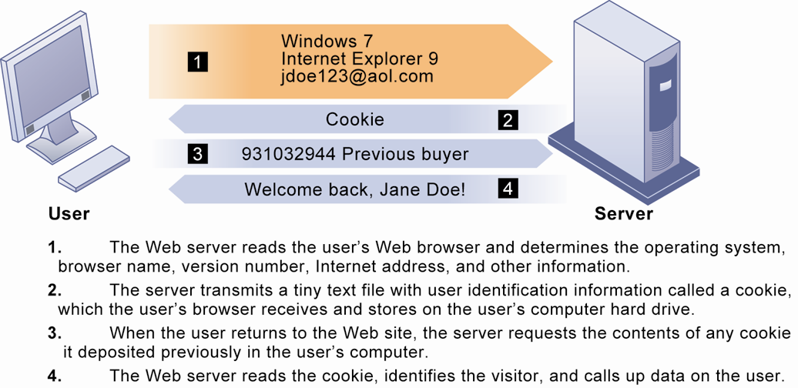
HOW COOKIES IDENTIFY WEB VISITORS
FIGURE 3
Cookies are written by a Web site on a visitor’s hard drive. When the visitor returns to that Web site, the Web server requests the ID number from the cookie and uses it to access the data stored by that server on that visitor. The Web site can then use these data to display personalized information.
Notes:
Ask students to pinpoint where potential privacy invasions might occur in the process shown above. Students may suggest that no real privacy violation is occurring in the figure, which is a legitimate point of view. If so, ask them how they might feel about a Web site they did not trust engaging in the displayed process.

Slide 31
The Moral Dimensions of Information Systems
The United States allows businesses to gather transaction information and use this for other marketing purposes.
  Opt-out vs. opt-in model
Online industry promotes self-regulation over privacy legislation.
However, extent of responsibility taken varies:
  Complex/ambiguous privacy statements
  Opt-out models selected over opt-in
  Online “seals” of privacy principles.
Notes:
Do students believe that businesses should be pressed to provide more comprehensive privacy protections online? Explain that businesses prefer the looser regulation, but that individuals may not. Also emphasize that most individuals do not take the proper steps to ensure their own privacy in any case. Most people do not know how to protect their privacy online. Does that mean that privacy is unimportant or that people don’t care?

Slide 32
The Moral Dimensions of Information Systems
Technical solutions
  E-mail encryption e.g. mail1click, lifehacker, e-mail riddler etc.
  Anonymity tools e.g. anonymizer or anonymous proxy
  Anti-spyware tools – come with antivirus tools
  Browser features
    “Private” browsing
    “Do not track” options
  Overall, few technical solutions.

Slide 33
The Moral Dimensions of Information Systems
Property rights: Intellectual property
  Intellectual property: intangible property of any kind created by individuals or corporations.
  Three main ways that intellectual property is protected:
    Trade secret: intellectual work or product belonging to business, not in the public domain.
    Copyright: statutory grant protecting intellectual property from being copied for the life of the author, plus 50 or 70 years – set by jurisdiction.
    Patents: grants creator of invention an exclusive monopoly on ideas behind invention for 20 years – set by WTO but indiv. member countries at liberty to set shorter term patents.
Notes:
Do students believe that the property rights guaranteed by trade secrets, copyrights, and patents are strong enough to avoid the theft of intellectual property online? Give an example of a trade secret (the formula for Coke; a method of doing business or business process). Give an example of a copyright (which could include the copyright of a photo or newspaper article). And give an example of a patent (such as Amazon’s One Click shopping as a business process patent, or Kodak’s claim to have a patent on digital still cameras with digital displays for a viewfinder).

Slide 34
The Moral Dimensions of Information Systems
Challenges to intellectual property rights
  Digital media different from physical media (e.g. books)
    Ease of replication
    Ease of transmission (networks, Internet)
    Difficulty in classifying software
    Compactness
    Difficulties in establishing uniqueness
Digital Millennium Copyright Act (DMCA) – (USA1998)
  Makes it illegal to circumvent technology-based protections of copyrighted materials.
Notes:
Students may be unwilling to admit to infringing upon intellectual property rights themselves, but ask them whether they are familiar with the Internet and its ability to bypass intellectual property protections. Do they believe that legislation such as the DMCA is having any effect? How many have friends who download “free” music from P2P sights? Free videos?

Slide 35
The Moral Dimensions of Information Systems
Accountability, liability, control
  Computer-related liability problems
    If software fails, who is responsible?
      If seen as part of machine that injures or harms, software producer and operator may be liable.
      If seen as similar to book, difficult to hold author/publisher responsible.
      What should liability be if software seen as service? Would this be similar to telephone systems not being liable for transmitted messages?
    Example: Who is responsible when bank paychecks are denied? Liability on developers? Similarity with book publishers for effects of a book.
Notes:
Using the example from the text, who do students consider to be the liable party for the incident involving Bank of America customers whose paychecks were denied due to an operating error at the bank’s computer center? Is it the designers of the systems at the center? Is there no liability involved? Explain that it is difficult to ascribe liability to software developers for the same reason that it is difficult to ascribe a publisher liability for the effects of a book.

Slide 36
The Moral Dimensions of Information Systems
System quality: Data quality and system errors
  What is an acceptable, technologically feasible level of system quality?
    Flawless software is economically unfeasible.
  Three principal sources of poor system performance:
    Software bugs, errors
    Hardware or facility failures
    Poor input data quality (most common source of business system failure) – GIGO!
Notes:
Do students have any opinion about when software is “good enough?” Does it depend on the particular product? For example, distinguish between software used by air traffic controllers and software used for word processing. Do students believe that there are different levels of acceptable quality for these products?

Slide 37
The Moral Dimensions of Information Systems
Quality of life: Equity, access, boundaries
  Negative social consequences of systems:
    Balancing power: although computing power decentralizing, key decision making remains centralized.
    Rapidity of change: businesses may not have enough time to respond to global competition.
    Maintaining boundaries: computing, Internet use lengthens work-day, infringes on family, personal time.
    Dependence and vulnerability: public and private organizations ever more dependent on computer systems.
Notes:
Ask students whether they have witnessed any of these negative consequences first hand. It’s likely that they know someone who has become dependent on their computer to some extent or have even experienced something similar first hand. Which of the above consequences do students feel is the most alarming?

Slide 38
The Moral Dimensions of Information Systems
Computer crime and abuse
  Computer crime: commission of illegal acts through use of computer or against a computer system—computer may be object or instrument of crime
  Computer abuse: unethical acts, not illegal
    Spam: high costs for businesses in dealing with spam
Employment:
  Reengineering work resulting in lost jobs
Equity and access—the digital divide:
  Certain ethnic and income groups in the world less likely to have computers or Internet access
Notes:
Ask students what experience they have had with spam. A notable statistic is that spam accounts for more than 75% of all e-mail traffic and is relatively unlikely to decrease, because it is so difficult to regulate and so cheap to send.
Do students believe that the end result of continuing advances in information technology will be rising unemployment and a small number of elite corporate professionals? Students may enjoy debating this idea, which is somewhat far-fetched, but conceptually stimulating. There is some evidence that today’s manufacturing technology (including robots and computer controlled machines) is displacing factory jobs.

Slide 39
The Moral Dimensions of Information Systems
Health risks:
  Repetitive stress injury (RSI)
    Largest source is computer keyboards
    Carpal tunnel syndrome (CTS) - pain, numbness, and other symptoms in the distribution of the median nerve due to its compression at the wrist in the carpal tunnel.
  Computer vision syndrome (CVS)
    Eyestrain and headaches related to screen use
  Technostress
    Aggravation, impatience, fatigue
Notes:
Have students encountered any of these health risks, either from personal experience or from someone they know?

Slide 40
Behavioral Targeting: Your Privacy Is the Target
Problem: Need to efficiently target online ads.
Notes:
Ask students if they know they are tracked on the Web. Would they like to know what information companies such as Google have about them? Do they feel comfortable that they can control and manage their online personal information, or, do they feel they have no control over this information? Ask students to imagine that, when they turn on their televisions to watch a show, more than one hundred cameras are activated inside the TV watching their every move, comment, and of course what show they are watching. Many Web sites today have more than one hundred tracking programs (“bugs”) on their home page.

Slide 41
Behavioral Targeting: Your Privacy Is the Target
Solution: Behavioral targeting allows businesses and organizations to more precisely target desired demographics.
Google uses tracking files to monitor user activity on thousands of sites; businesses monitor activity on their own sites to better understand customers.
Demonstrates IT’s role in organizing and distributing information.
Illustrates the ethical questions inherent in online information gathering.
Notes:
Ask students if they know they are tracked on the Web. Would they like to know what information companies such as Google have about them? Do they feel comfortable that they can control and manage their online personal information, or, do they feel they have no control over this information? Ask students to imagine that, when they turn on their televisions to watch a show, more than one hundred cameras are activated inside the TV watching their every move, comment, and of course what show they are watching. Many Web sites today have more than one hundred tracking programs (“bugs”) on their home page.

Slide 42
Ethical and Social Issues in Information Systems
VIDEO CASES:
  Case 1: Data Mining for Terrorists and Innocents
  http://www.youtube.com/watch?v=4lKpD7MC22I

Slide 43
Summary
Ethical and Social issues related to Systems
The Moral dimensions of Information Systems
The five moral dimensions of the information age:
    Information rights and obligations
    Property rights and obligations
    Accountability and control
    System quality
    Quality of life
Notes:
Students may not know exactly what is meant by globalization or may have an incomplete understanding of the term. You might ask students what they think it means. Potential answers could include: reduction of economic and cultural advantages of developed countries, increased number of companies with operations in multiple countries worldwide, and increased reliance on imports and exports of goods (and jobs). Globalization will be discussed in later slides as well.

Slide 44
Summary
Key technology trends that raise ethical issues:
    Doubling of computer power
    Rapidly declining data storage costs
    Networking advances and the Internet
Five step ethical analysis:
    Identify and describe the facts
    Describe dilemma and identify higher-value orders
    Identify stakeholders
    Identify options you can reasonably take
    Identify potential consequences of options
Notes:
Students may not know exactly what is meant by globalization or may have an incomplete understanding of the term. You might ask students what they think it means. Potential answers could include: reduction of economic and cultural advantages of developed countries, increased number of companies with operations in multiple countries worldwide, and increased reliance on imports and exports of goods (and jobs). Globalization will be discussed in later slides as well.

Slide 45
Next……
IT Infrastructure and Emerging Technologies

